Slide 1
ENSE 470 Milestone 2
Jeremy Cross
Iden Ellia
Abdullah Alasmari

Slide 2
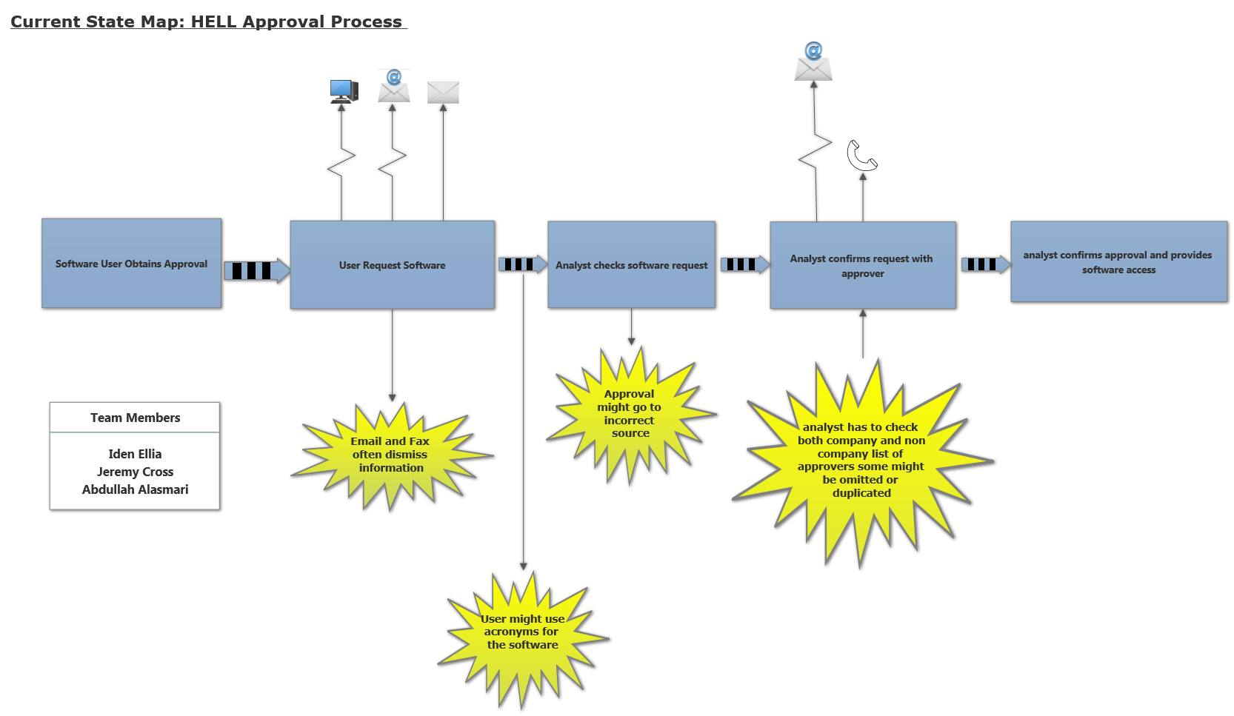
Recalling Current State VSM and Kaizen Bursts

Slide 3
Idea Sheet 1
Describe your idea sheets and any categories/themes that emerged

Slide 4
Idea Sheet 2

Slide 5
Idea sheet 3

Slide 6
Idea sheet 4

Slide 7
Future state VSM
Display your completed future state VSM
Emphasize the differences from the current state VSM
Share reasons for choosing areas to improve

Slide 8
Group reflection
How did you feel about this milestone? What did you like about it? What did you dislike?
It was good, smartdraw sucks
What did you learn about yourself as you collaborated and worked through this milestone?
We learned how to create idea sheets
Learned how to draw stick people lolz
How will you use what you have learned going forward?
We will use our future state diagram for milestone 3
What “stuff & things” related to this milestone would you want help with?
Stick people!!!!!!!

